Slide 1

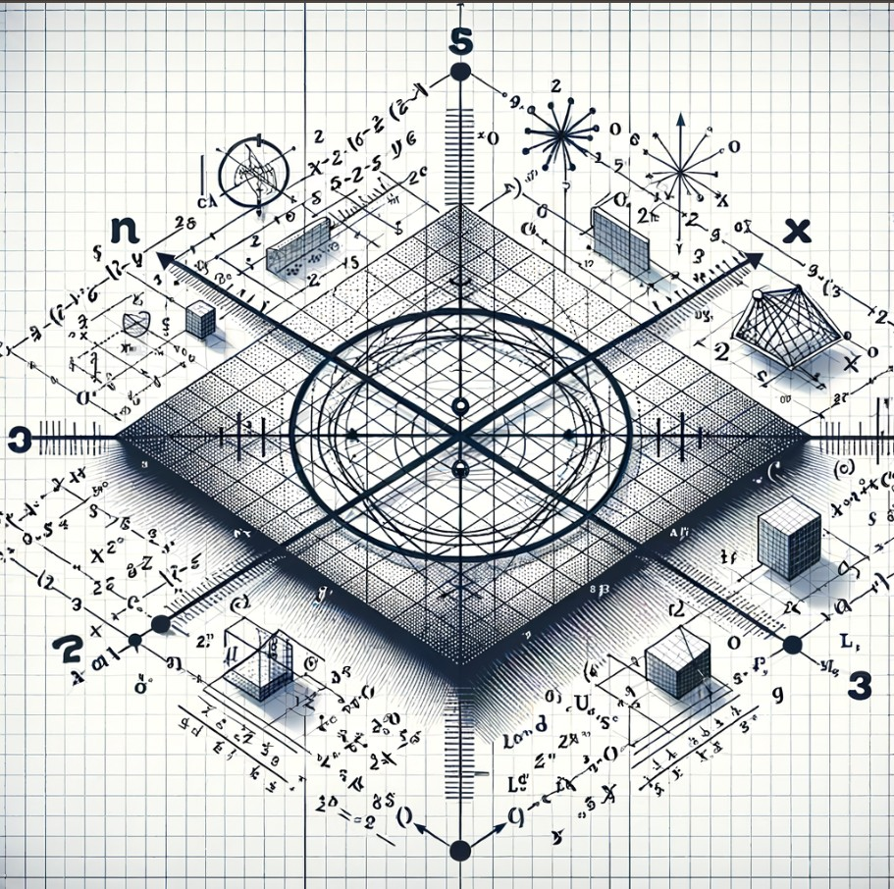
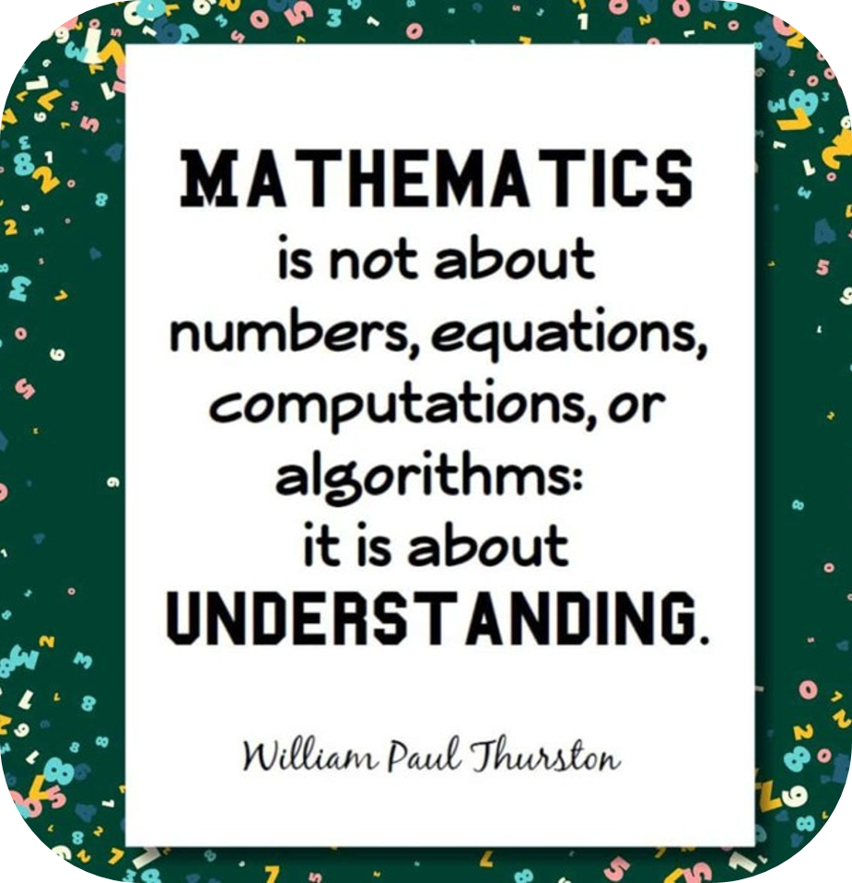
Mathematics 2024
Conic
Section
By Dhiraj Mallik , Jayesh , Mohit , Kunal

Slide 2
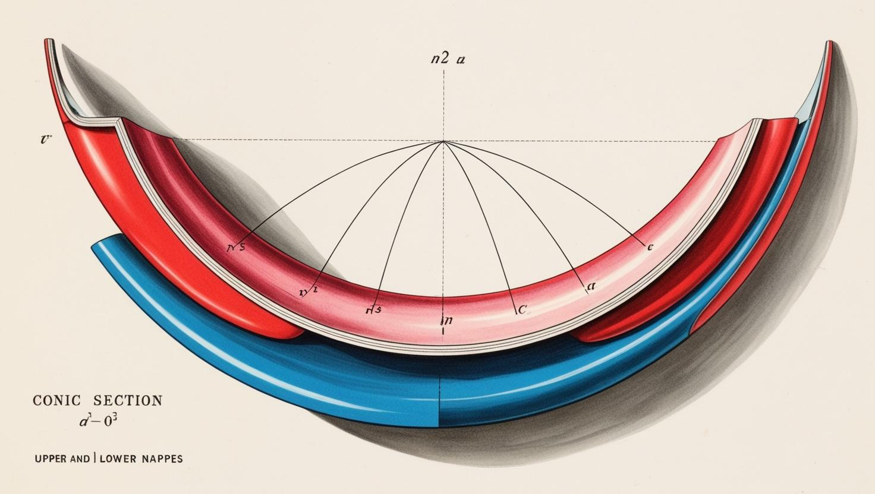

WHAT ARE CONIC SECTIONS ?
A curve, generated by intersecting a right circular cone
with a plane is termed as ‘conic'. The vertex of the cone
divides it into two nappes referred to as the upper
nappe and the lower nappes.
The point V is called vertex and the line “l” is called axis of
cone. The rotating line m is called generator of cone .
The vertex separates cone into 2 parts called nappes.

Slide 3
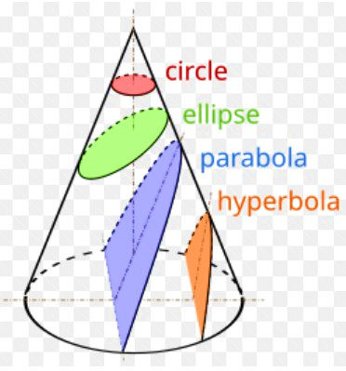
Curves have huge applications everywhere, be it the study of planetary motion, the design of telescopes, satellites, reflectors etc.
Let β be the angle made by the intersecting plane with the vertical axis of the cone.
(a) When β = 90 degree the section is a circle .
(b) When α < β < 90 degree , the section is an ellipse.
(c) When β = α; the section is a parabola
(d) When 0 ≤ β < α; the plane cuts through both the nappes and the curves of intersection is a hyperbola.

Slide 4
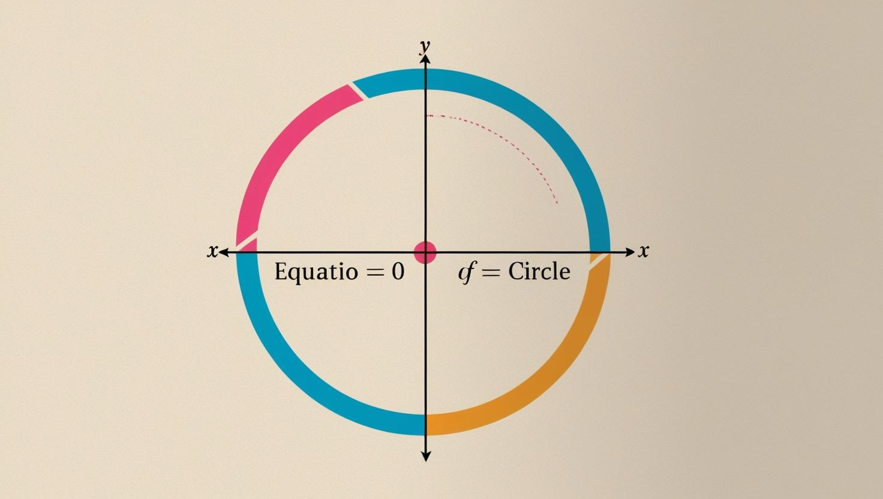
Circle:
It is set of all point in a plane that are equidistant from a
fixed point in a plane or form a fixed locus in a plane.
Formula of circle is: (x – h)² + (y – k)² = r².
Some common terms and theorems:
Arc: it is a portion/part on the circumference of circle
Chord :a chord is the line segment joining two points on a circle.
Segment : the segment of a circle is the area enclosed by an arc
of a circle and a chord.

Slide 5
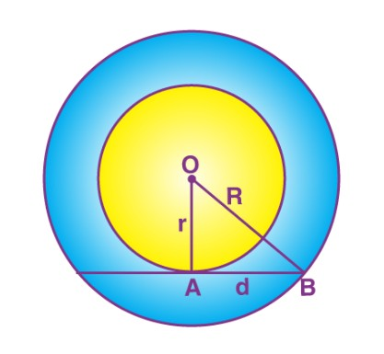
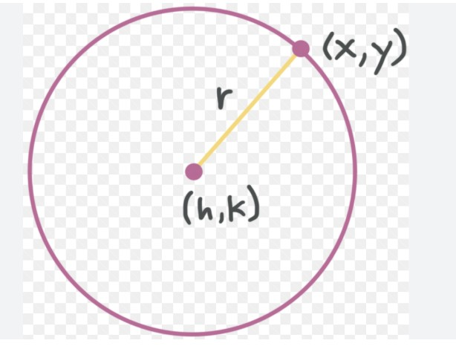
“the tangent to the circle at any point is the perpendicular to the radius of the circle that passes through the point of contact”.
Eccentricity : The eccentricity of parabola is the ratio of the distance of a point on the parabola from a fixed point (focus) and the perpendicular distance of the point from a fixed line (directrix).
Annulus-The region bounded by two concentric circles. It is basically a ring-shaped object.

Slide 6

Parabola :
A parabola is the set of all points in a plane that are equidistant from a
fixed line and a fixed point (not on the line) in the plane.
The name parabola and hyperbola are given by Apollonius.
Focal distance: the distance of point “P” from the focus on the point on
parabola.
Focal chord: a chord of parabola which passes through focus.
Double ordinate: A chord of parabola perpendicular to axis of symmetry of
parabola.
Foot of directrix : the point of intersection of axis of symmetry and directrix.
It is represented by N.
Latus rectum: A double ordinate passing through focus and the focal chord
perpendicular to axis of parabola. length of chord is called latus rectum(4a).
NOTE : Two parabolas are said to be equal if they have Same length of
lactus rectum.

Slide 7

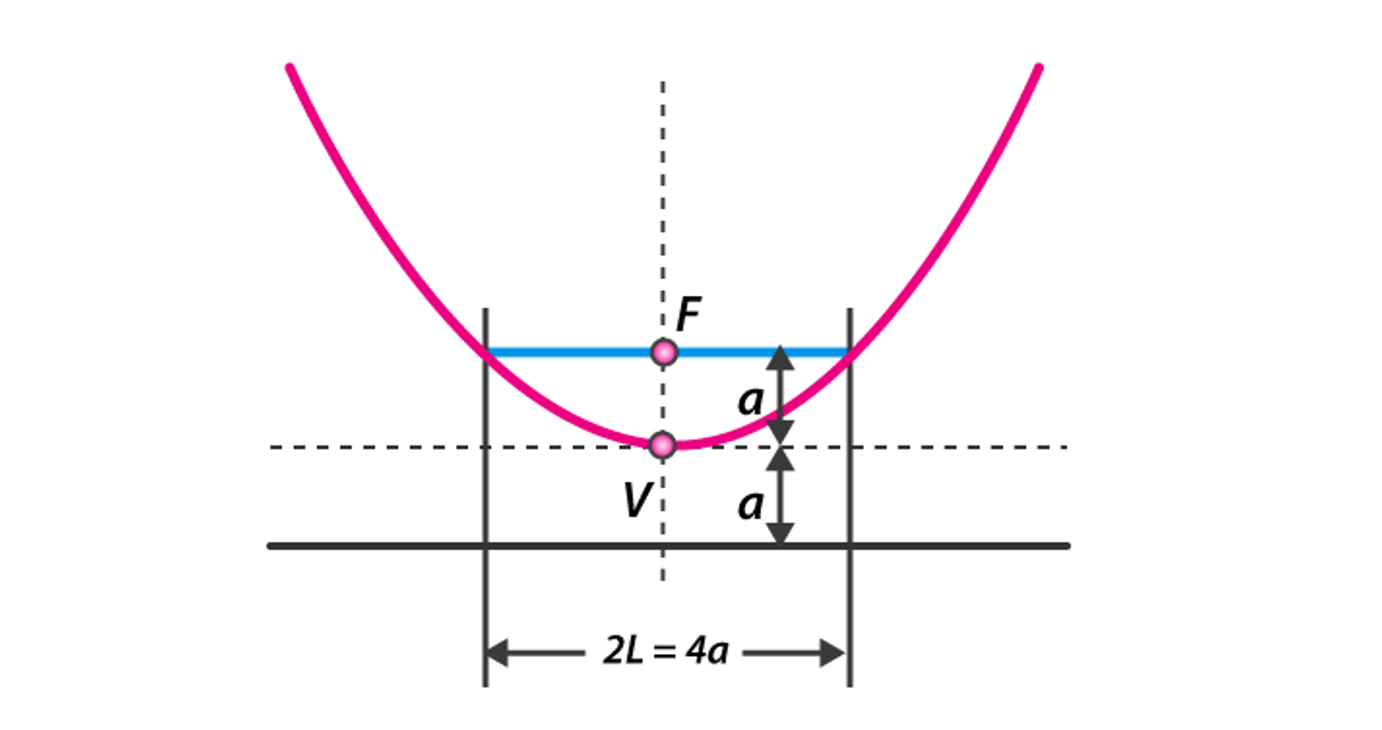
A parabola has one directrix, similar to the focus, but ellipses and hyperbolas have two.

Slide 8
Standard equation of Parabola:
FORMS OF PARABOLA | y²=4ax | y²=(-4ax) | x²=4ay | x²=(-4ay)
Axis | y = 0 | y = 0 | x = 0 | x = 0
Directrix of parabola | x = -a | x = a | y = -a | y = a
Vertex | (0, 0) | (0, 0) | (0, 0) | (0, 0)
Focus | (a, 0) | (-a, 0) | (0, a) | (0, -a)
Length of latus rectum | 4a | 4a | 4a | 4a
Focal length | |x + a| | |x – a| | |y + a| | |y – a|

Slide 9
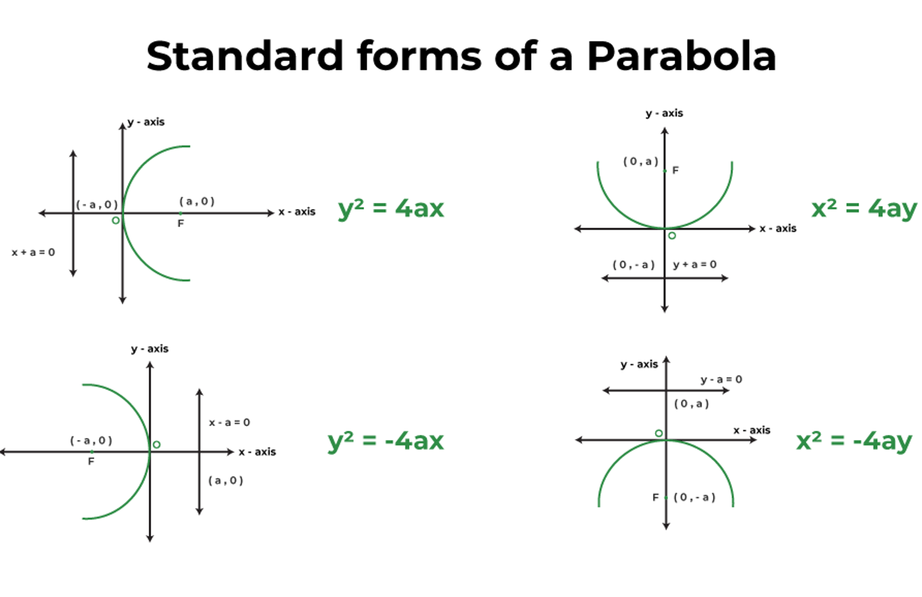

Slide 10
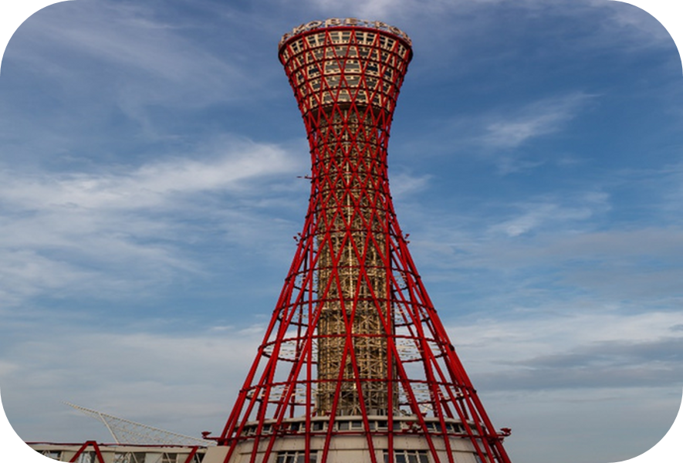
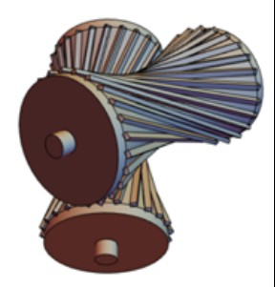
Practical example of some conic section images :
The kobe tower in japan has a hyperbolic shape gives decorative shape and also provide a greater stability against air resistance .
Gears are used to alter the speed and torque of a power source used in an automobile.

Slide 11


The stretched arc of rocket is parabolic .
Merry Go Round track while playing.

Slide 12
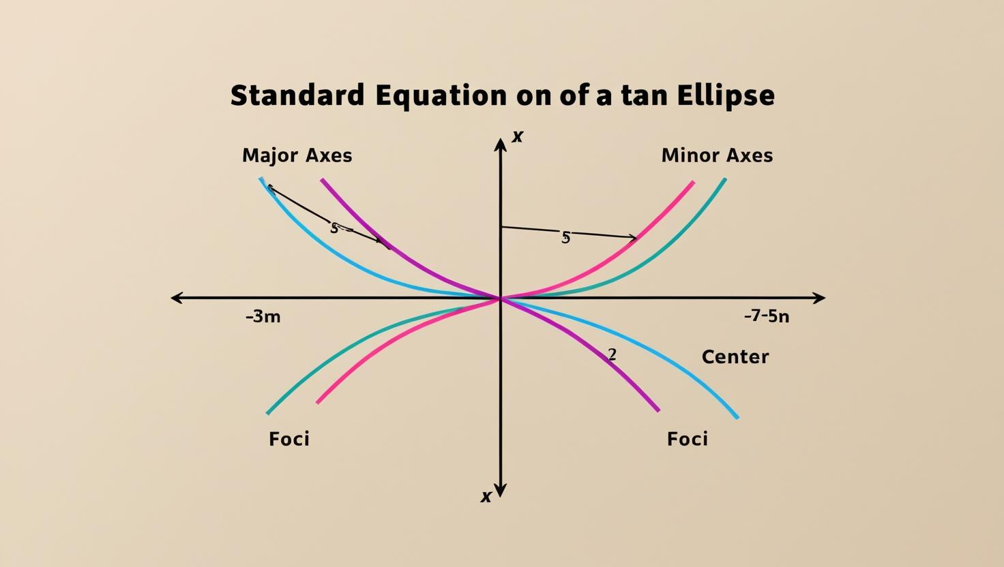
Ellipse:
The ellipse is one among the conic sections that’s produced, when a plane cuts the cone at an angle with the bottom.
Ellipse has two focal points, which are called foci.
The fixed distance parallel to the latus rectum and perpendicular to the major axis is termed the directrix.
The eccentricity of the ellipse 0 ≤ e < 1
Ellipse has a major axis, a minor axis and a centre.
The Standard form of equation of ellipse is
(x-h)² / a² + (y-k)² / b² = 1

Slide 13
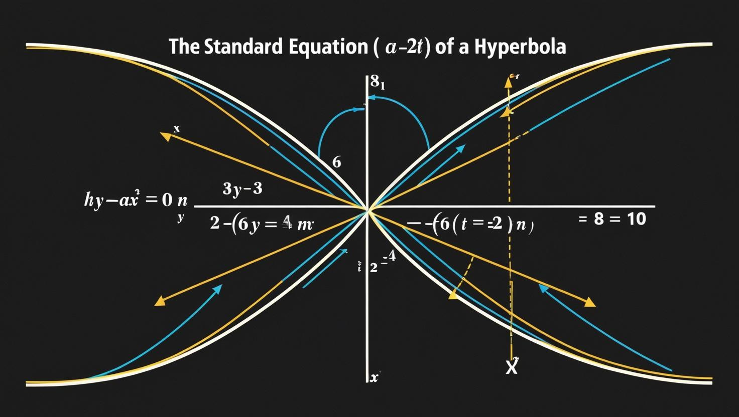
Hyperbola
When a plane is parallel to the central axis of a cone, it touches both halves of the double cone, forming a hyperbola.
Formulas :
(x-h)² / a² – (y-k)² / b² = 1
A hyperbola’s eccentricity is constrained to e > 1 and has no upper bound. When the eccentricity is allowed to reach +∞, the hyperbola degenerates into a straight line, which is one of its degenerate examples.
A hyperbola’s other degenerate situation is to become its two straight-line asymptotes. When the plane intersects the apex of the double cone, this occurs.

Slide 14
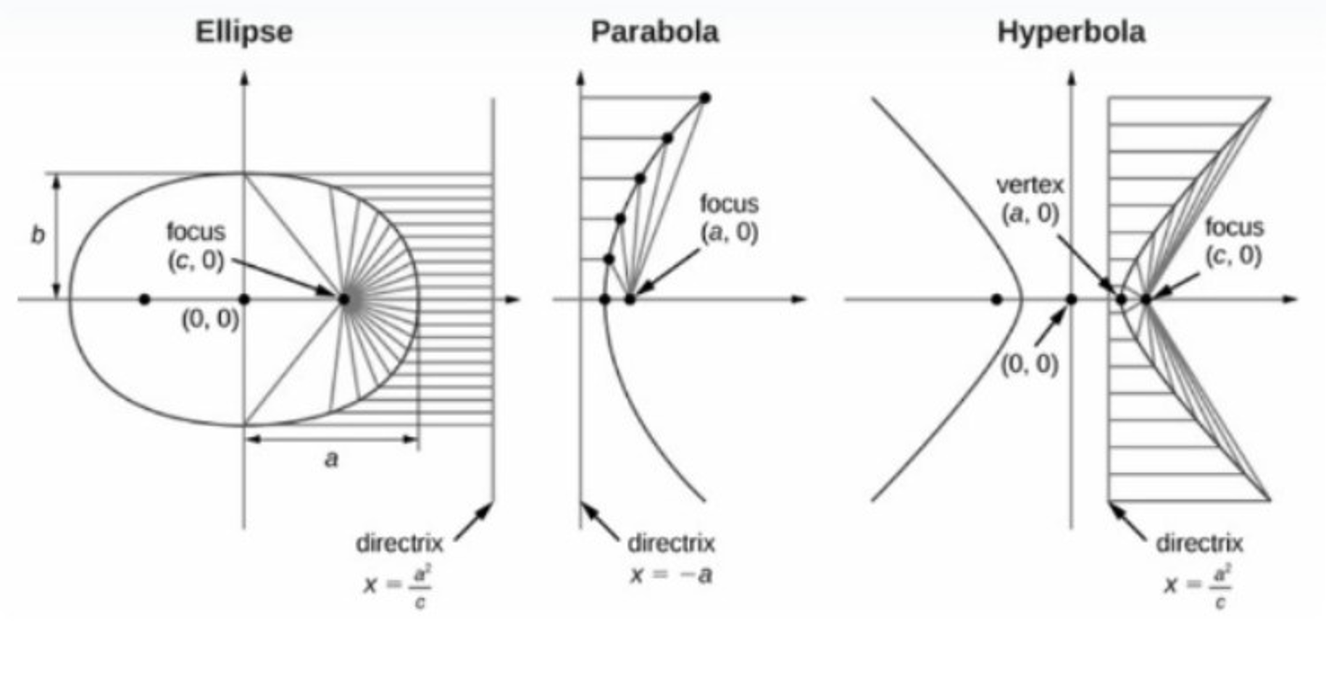

Slide 15

Note: Common Parts of Conic Sections
The focus of the conic section is the point
around which it is built. In other words,
it is the point at which the curve’s reflected
rays converge.
An ellipse and hyperbola both have two
points of emphasis around which the shape
is built.
A directrix is a line that is used to define
and create a conic section. The distance
between a directrix and a point on a conic
section is proportional to the distance
between that point and the focus.

Slide 16
Ask Question ?

Slide 17
Quiz time :
It is a set of all coplanar points such that the distance from a fixed point is constant.
Circle
Parabola
Ellipse
Hyperbola.
Answer: (a) Circle
For the ellipse 3x²+4y² = 12, the length of the latus rectum is:
2/5
3/5
3
4
Answer: (c) 3
The length of the latus rectum of x² = -9y is equal to
3 units
-3 units.
-9/8 units
9 units
Answer: (d) 9 units

Slide 18
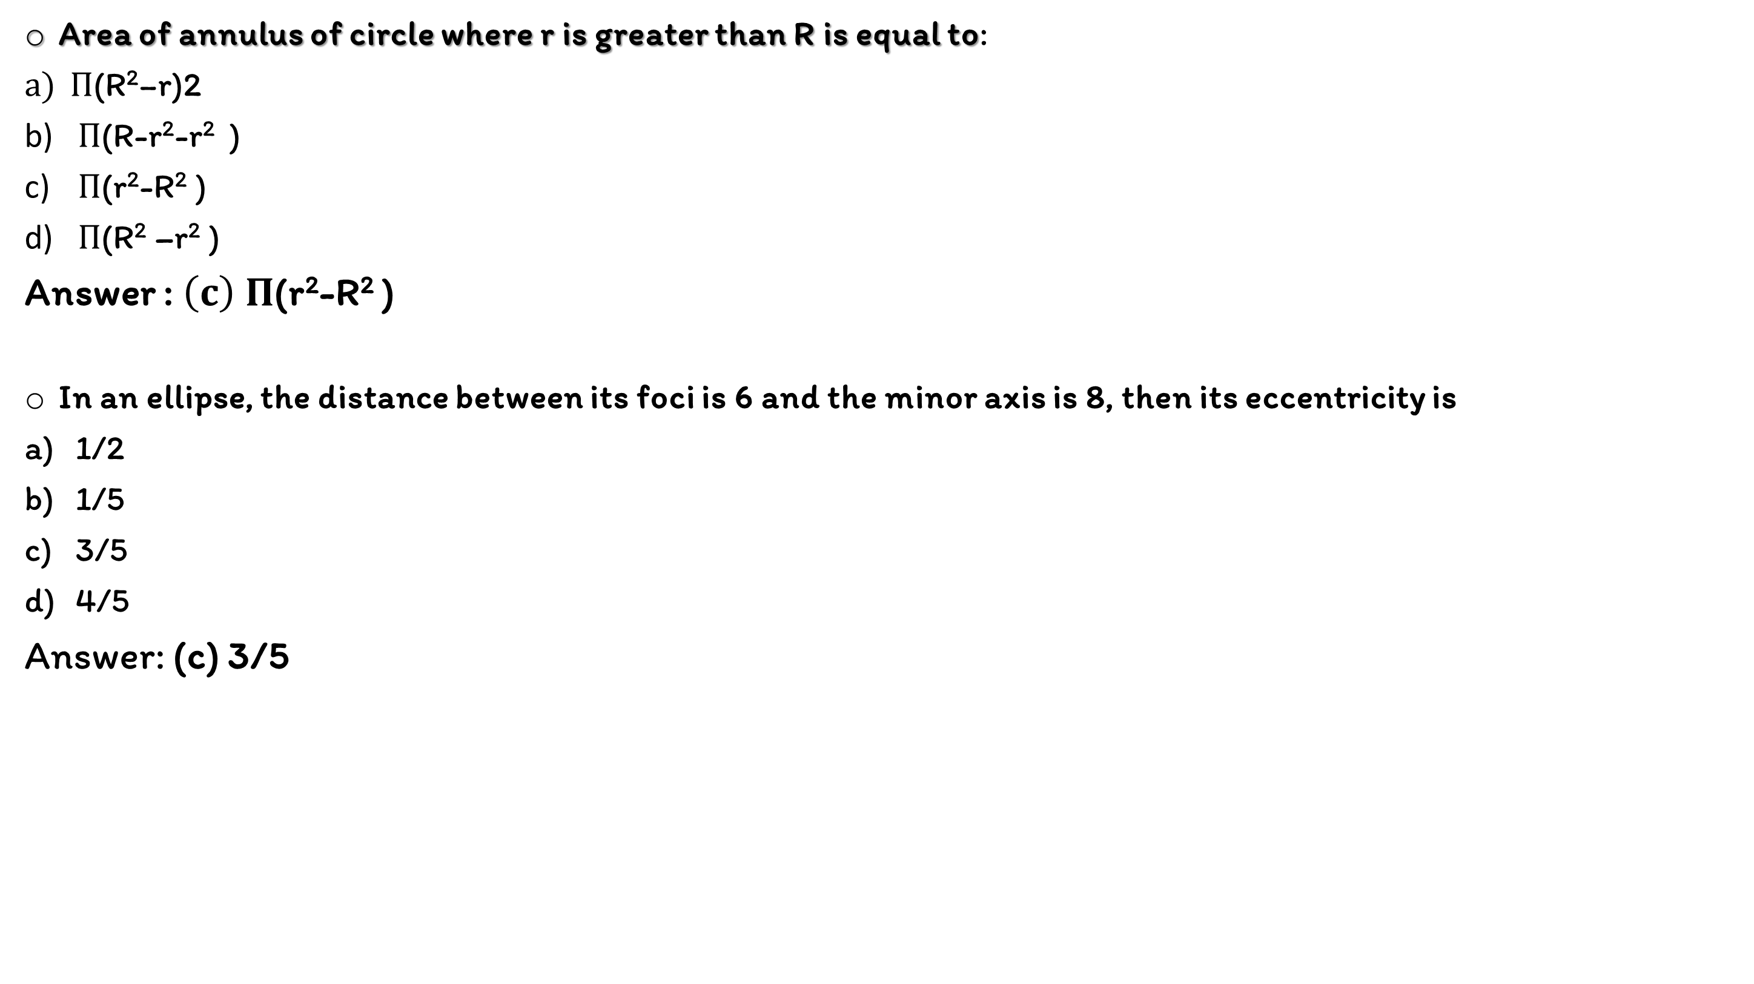
Area of annulus of circle where r is greater than R is equal to:
$Π\text{(}\text{R}\text{2}\text{−}\text{r}\text{)2}$
$Π$(R-r²-r² )
$Π$(r²-R² )
$Π$(R² –r² )
Answer : $\left(c\right) Π$(r²-R² )
In an ellipse, the distance between its foci is 6 and the minor axis is 8, then its eccentricity is
1/2
1/5
3/5
4/5
Answer: (c) 3/5

Slide 19
Thank You

